Slide 1

Microenterprise
Collaborative of Inland Southern California
www.microbizinsocal.org

Slide 2


Welcome to the
Microenterprise Collaborative of Inland Southern California

Slide 3
The purpose of the Microenterprise Collaborative of Inland Southern California is to create and grow sustainable small businesses and job development by supporting micro business development agencies.
Empower small businesses through collaborative efforts

Slide 4



Audience
90% of all businesses in Inland Southern California are micro-businesses.
Diverse Entrepreneurs
Underserved Communities
Empowering individuals from varied backgrounds to succeed.
Supporting marginalized groups with innovative solutions.

Slide 5




Programs
Comprehensive Programs
Tailored Solutions
Supporting small businesses with Resources & Access to Capital
Grants for Small Businesses
Educational Website & BLOG
E-Newsletters
All resources in English & Spanish
Customized for success Capacity Building
Small Business Assistance Tool
Strategic Guidance
Driving growth and innovation
Networking
Advocacy for Small Businesses

Slide 6

THE MICROENTERPRISE COLLABORATIVE
Provides Access to Capital
Works with microlenders to provide small loans to help businesses grow
Has programs focused on helping small business owners become employers, aiming to create more jobs in the local economy
Builds the capacity of service providers & micro-development agencies to meet the
growing demand for small business support

Slide 7


Training and Consulting Services
The co laborative offers training and consulting in various business ski ls, including:
01
Management & Business Skills Development
02
Finance
03
Marketing

Slide 8




Community Engagement
With over 700 partners, including banks, Chambers of Commerce, business associations, nonprofits, universities, and government agencies, Microenterprise Collaborative facilitates networking and collaboration opportunities for small businesses

Slide 9


Yet another idea
Fostering collaborations for greater community impact
One idea
Another idea
Awesome

Slide 10
Timeline
Journey through Impactful Initiatives
2011
2012
2013
2014
2015
2016
2017
2018
2019
2020
2021
2022
2023
2024
2025
New
Inception
Fiscal
Executive
Growth
Sponsorship
Director
Seed Money from B of A
Impact
Impact
Impact
Impact
501(c)(3)
Status
Impact &
Expansion

Slide 11


Contact
Become a part of our mission to empower sma l
businesses. Visit our website or contact us today!
Microenterprise Collaborative 14050 Cherry Ave.
Ste R PMB 1108
Fontana, CA 92337
Pamela Deans, Executive Director pdeans@microbizinsocal.org
+1-909-587-1788

Slide 12

Retail Theft
Prevention Program

Slide 13

Organized Retail Theft Prevention Grant
City awarded $2,219,710 to combat retail and motor vehicle theft in collaboration with Riverside County Sheriff’s Department
Funding over three-year period
Awarded to cities to address escalating issue of organized retail theft in California

Slide 14
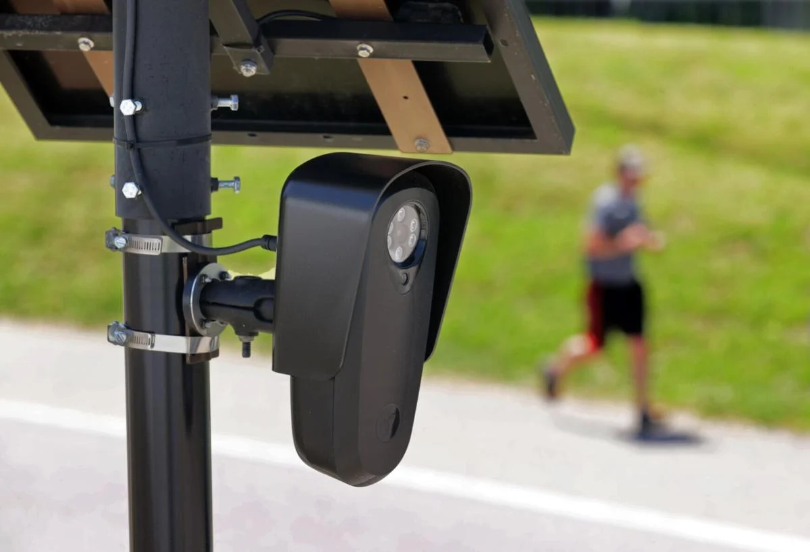
Program Highlights
ALPR Cameras
60 automatic license plate readers city-wide
Capture rear of vehicle
Notify law enforcement when a vehicle of interest is spotted
Retail & Motor Vehicle Theft Task Force
Investigate vehicle and retail theft crimes
Increase law enforcement presence
Deter criminals from engaging in retail theft
Business Outreach
Empower businesses with retail theft prevention strategies

Slide 15
What is CPTED?
Crime Prevention Through Environmental Design is the proper design and effective use of the built environment that can lead to a reduction in the fear and incidence of crime and an improvement in the quality of life.
The goal of CPTED is to reduce opportunities for crime that may be inherent in the design of structures or in the design of neighborhoods.

Slide 16
Key Components of CPTED
Natural Surveillance
Access Control
Territorial Reinforcement
Maintenance

Slide 17
Natural Surveillance
Natural Surveillance is supported by the placement of physical features, activities, and people in a way that maximizes visibility.
Designing landscapes that allow clear, unobstructed views of surrounding areas
Improving visibility with lighting or transparent building materials
Avoiding lighting that creates glare or shadows
Avoiding the creating of entrapment areas.

Slide 18
Natural Surveillance
Private space can be easily observed
Users of the space feel they are being watched over
The feeling that you are being observed impacts behavior

Slide 19
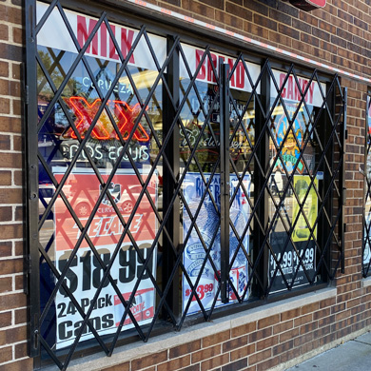

Slide 20
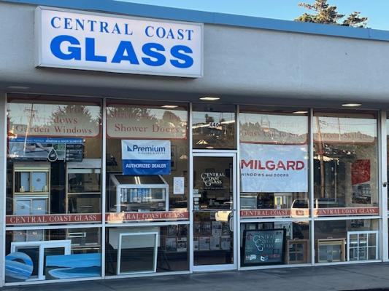

Slide 21
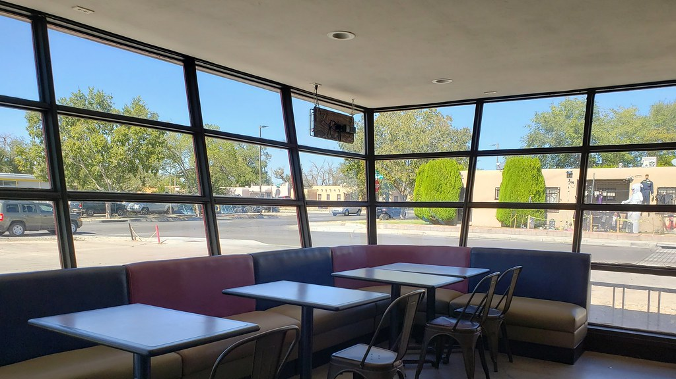

Slide 22
Natural Surveillance
Design can be reinforced mechanically
Security personnel
Surveillance cameras
Mirrors
Through policy
Greeting customers
Zone responsibilities

Slide 23
Lighting
In CPTED, lighting has two purposes: human activity and security
Lighting helps an individual observe their surroundings and respond to a potential threat
Pathways must be illuminated to the point where faces can be observed

Slide 24
Lighting
Poor lighting, whether too bright or not bright enough can diminish safety
Quality of lighting is as important as quantity
Lighting can effect the appearance of colors and objects
A security officer leaving a well lit area and entering darkness will require 20 minutes to become fully dark adapted

Slide 25
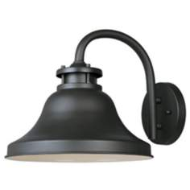
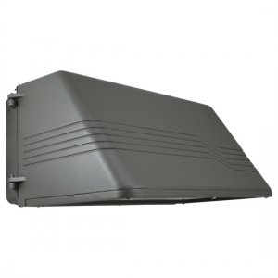
Lighting
White light (e/g/ metal halide, LED, fluorescent, or induction)
Fixtures should be “cutoff” or “full cutoff” to limit glare and light trespass (also known as “dark sky”)

Slide 26
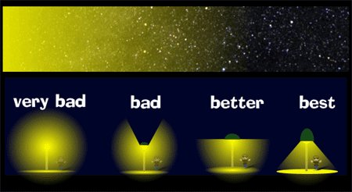
Lighting

Slide 27
Access Control
By selectively placing entrances and exits, workstations and activity areas to control the flow of or limit access, Natural Access Control occurs.

Slide 28
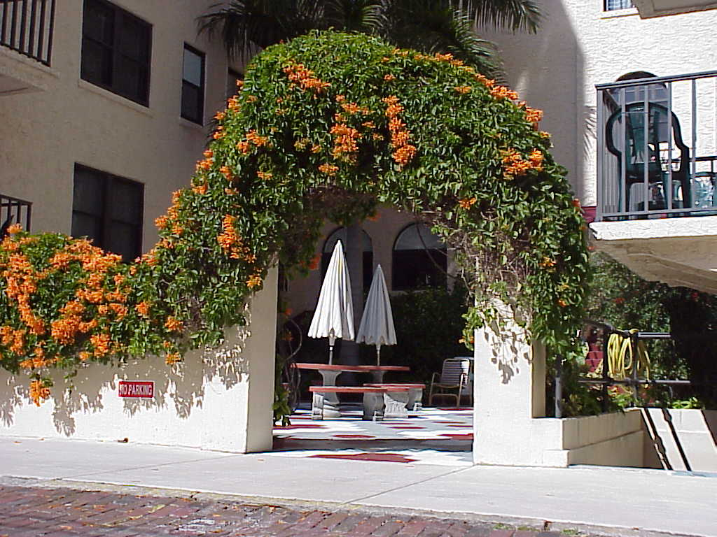
Access Control
Allows observance of legitimate users
Restricts ability to enter private space unobserved
Intruders stand-out

Slide 29
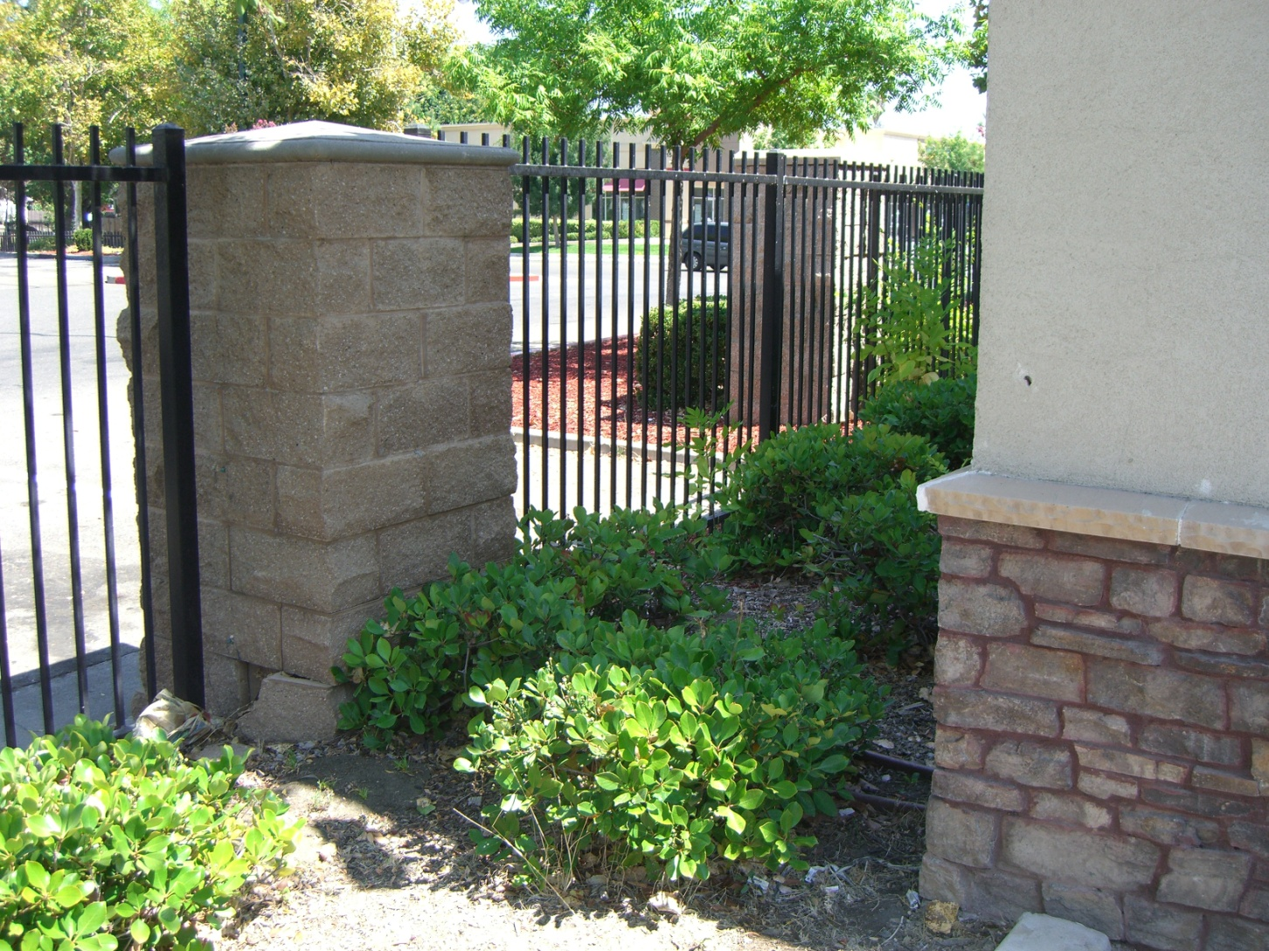
Access Control
Design can be reinforced mechanically
Fences
Landscaping
Barricades
Through policy
Door locking policies
Visitor sign-in

Slide 30
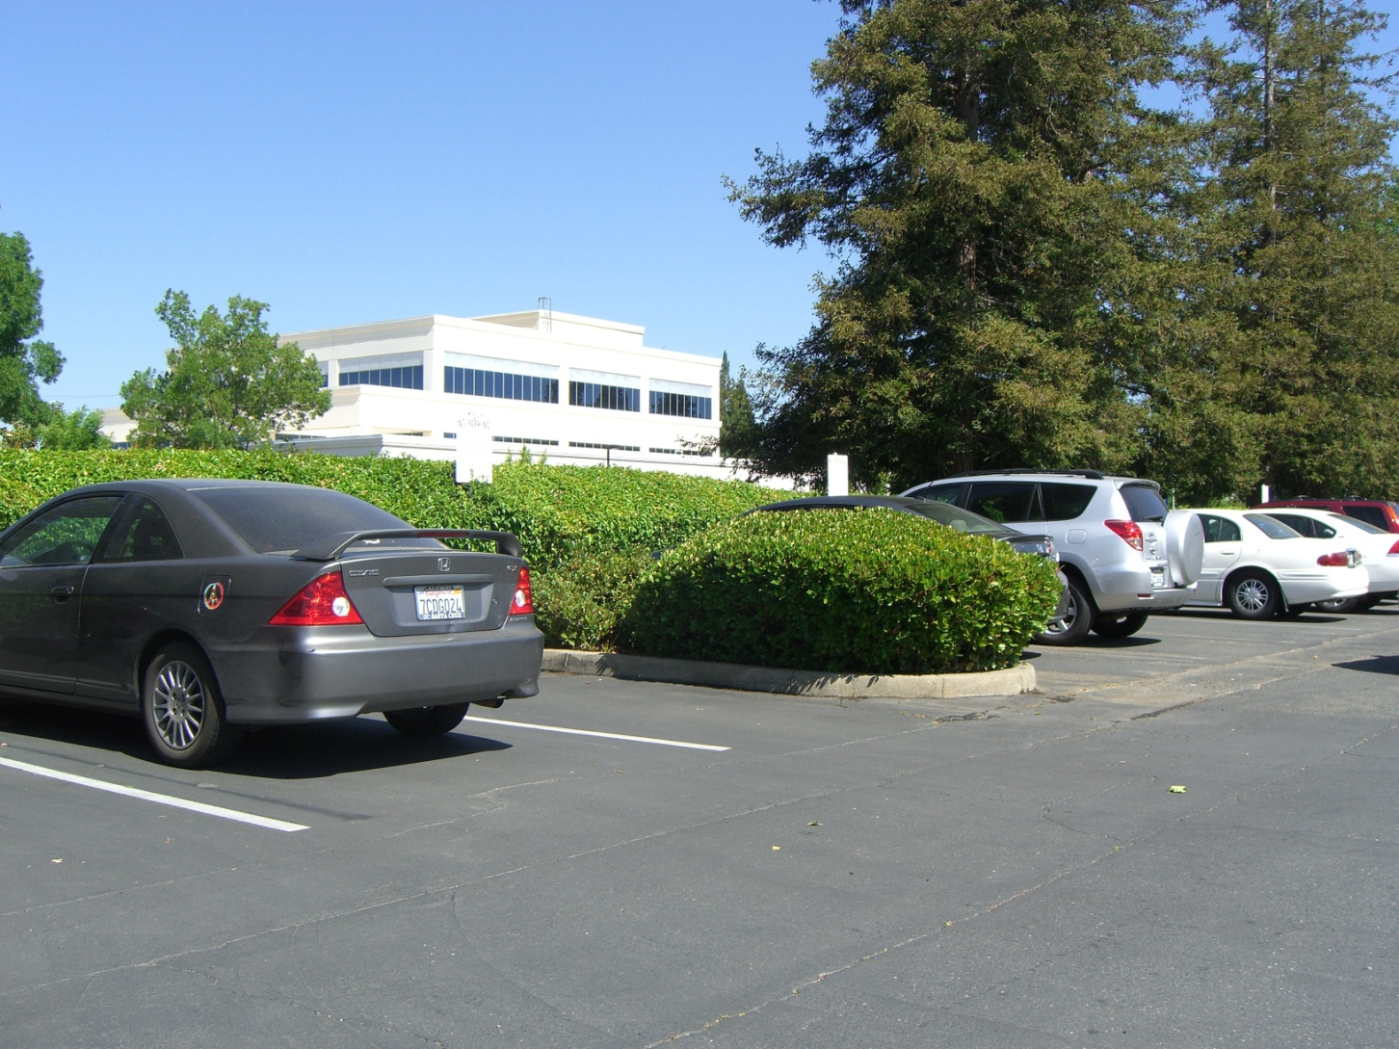
Access Control
Barriers can be physical
Security screen doors
Wrought iron gates and fencing
Card or keypad locking systems
Or Symbolic
Changes in pavement
Low hedges and flower beds

Slide 31
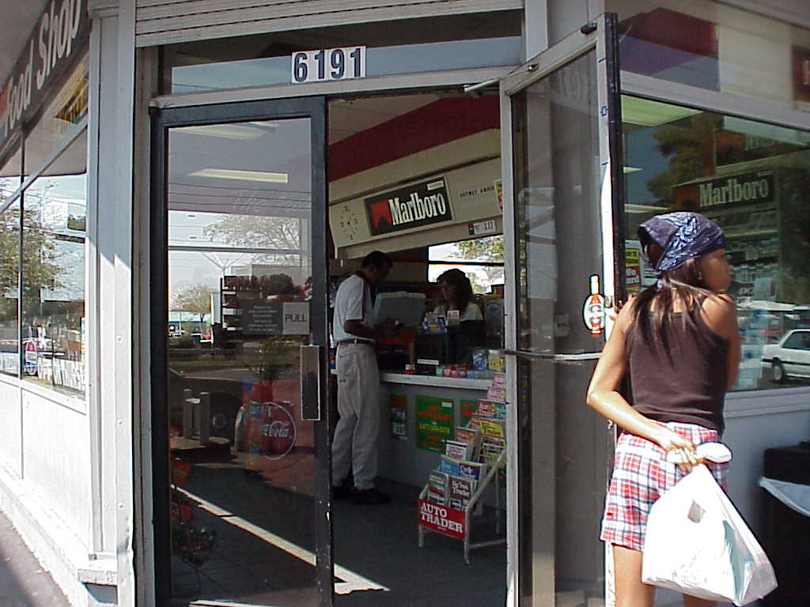
Access Control
Locate check-out counters at the front of the store, clearly visible from the outside. When positioned near the main entrance, employees can better watch activities

Slide 32
Territorial Reinforcement
By designing an environment to delineate private space clearly, Natural Territoriality occurs.

Slide 33

Territorial Reinforcement
Creates a sense of ownership
“Owners” have a vested interest and will more likely report an intruder
Results in an environment where intruders stand out, are more easily identified and feel uncomfortable

Slide 34
Territorial Reinforcement
Statement of ownership can be made physically
Neighborhood Watch sign
No Trespassing signage
Or Symbolic
Well-kept appearance of grounds
A friendly smile or wave hello

Slide 35
Maintenance
Maintenance allows for the continued use of a space for its intended purpose. Maintenance serves as an additional expression of ownership and prevents the reduction of visibility from landscaping overgrowth and obstructed or inoperative lighting.

Slide 36
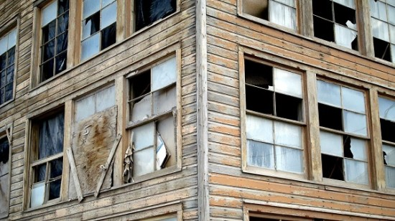
Broken Window Theory
“The presence of a broken window will entice vandals to break more windows in the vicinity.” – Wilson and Kelling, 1982 (Atlantic Monthly)

Slide 37
CPTED
The CPTED theory advocates that all possibilities for natural crime prevention be exhausted, prior to the involvement of the mechanical and organized strategies.

Slide 38

Crime Prevention Through Customer Service
Greet All Customers
Welcome all customers
Acknowledge each customer so they know they’ve been seen
Maintain Adequate Staffing Levels
Shoplifters often work in pairs
Having enough employees on the sales floor can deter shoplifting from taking place
Customer Assistance
Ask customers if they need assistance
Demonstrates attentiveness to potential shoplifters

Slide 39

Crime Prevention Through Customer Service
Utilize Signage
Use signs to notify customers of installed cameras
Notifies shoplifters that they will be prosecuted
Train Employees
Ability to spot scams such as price switching and false returns
Anti-theft protocols such as the size of bags allowed in the store
Alerting store managers of potential shoplifters
Inventory Management Tools
Knowing your inventory allows you to determine what kind of items are being stolen
Adjust security measures (mirrors, locked display cases

Slide 40
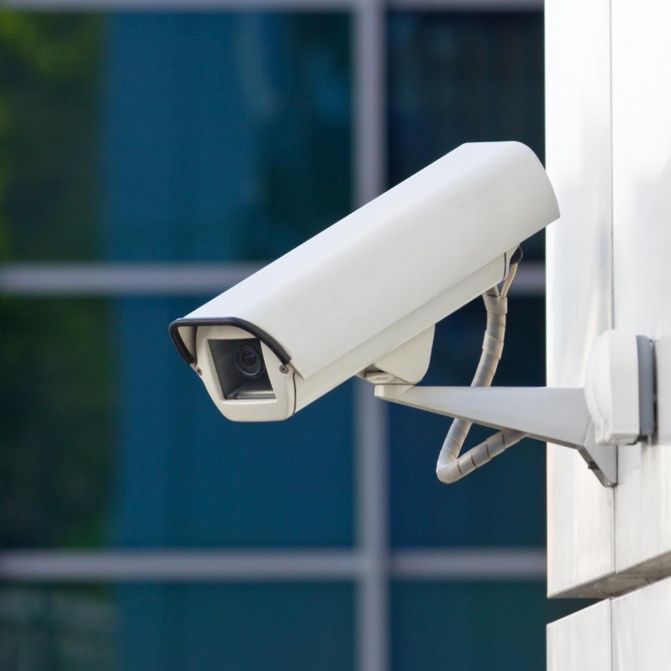
Security Cameras
High Definition is best. Otherwise the more pixels the better
Digital storage (DVR or off-site)
30 days of storage (1 terabyte for most homes)
Support standard MPEG formats
Surge protected
Low light, auto focus and auto iris

Slide 41

Shoplifting Tactics
Working in Pairs
One person distracts staff while the other pockets goods
Hiding Products
Hiding products in clothing, other items they’ve actually purchased, handbags, strollers, reusable shopping bags, or their shoes
Price Switching
Thieves will often swap price tags or labels from one product to another
Grab and Run
During busy periods of the day or when staff is preoccupied, shoplifters will dash into the store and run with items

Slide 42
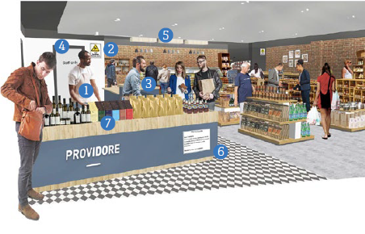
Crime Prevention Through Environmental Desing
Staff clearly overlooking retail environment
Surveillance camera positioned over service area, store displayed and patron areas
Support and service staff for patrons
Clearly defined “staff only” areas
Well-lit service area, store displays and patron areas
Signage indicating terms of entry or store conditions
High-price items closer to counter

Slide 43
Contact Us
Michael Perez
Email: mperez@jurupavalley.org

Slide 44
Retail Theft
Prevention Program

